Slide 1

Welcome!
Code for Climate

Slide 2
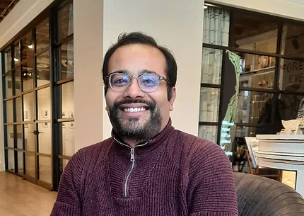
Introductions: Dr. Somesh Roy
Associate Professor
Director, Computational Combustion Lab (CCL)
Historian of soot
Favorite food: Lentil soup

Slide 3

Introductions: Khaled Mosharraf Mukut, PhD Computational Combustion Lab (CCL) Marquette University
From Bangladesh
Curious to learn new things
Love travel and photography
Gets bored quick doing repetitive things
Favorite food: Biriyani

Slide 4

Introductions: Evan Gventer Computational Combustion Lab (CCL) Marquette University
Third year PhD student
From Cedarburg, WI
Loves reading, learning about the weather, hiking, and going to the beach!
Favorite food: Tacos

Slide 5
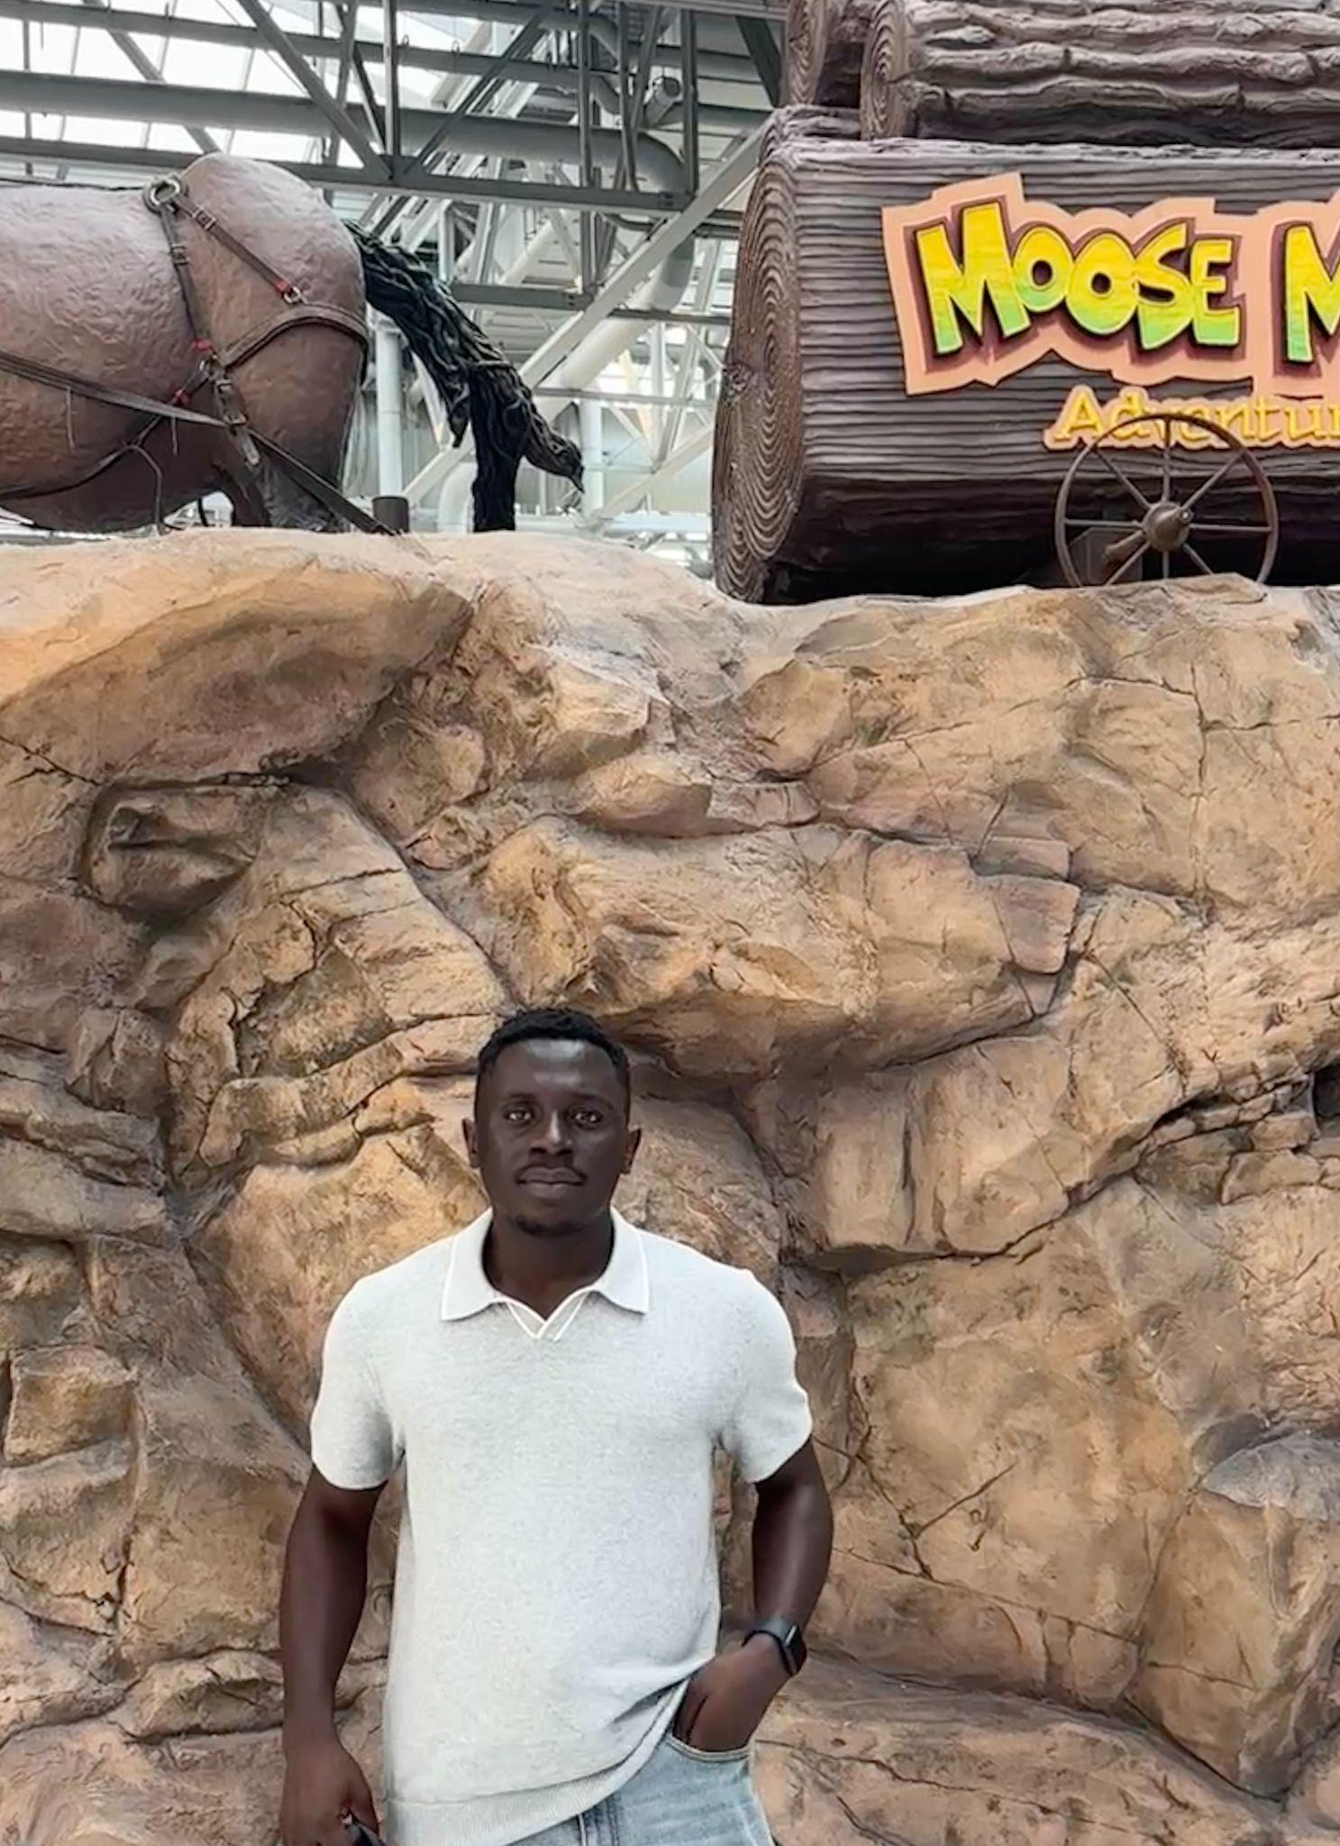
Introductions: John Omokayode Computational Combustion Lab (CCL) Marquette University
From Southwest, Nigeria
I love to see new places
I really enjoy the outdoors - a walk, bike ride etc.
I love to unwind baking random new recipes I find online.
Favorite food: Jollof Rice.

Slide 6
Now it’s your turn!
Tell us how you want us to call you
Tell us something – other than which school or grade you are in – about yourself. Maybe …
some interesting facts
what you did this summer
or, something else, altogether!
What's your favorite food to make for yourself to eat — even if it's just a snack or something very simple?
Ask me something – anything!

Slide 7
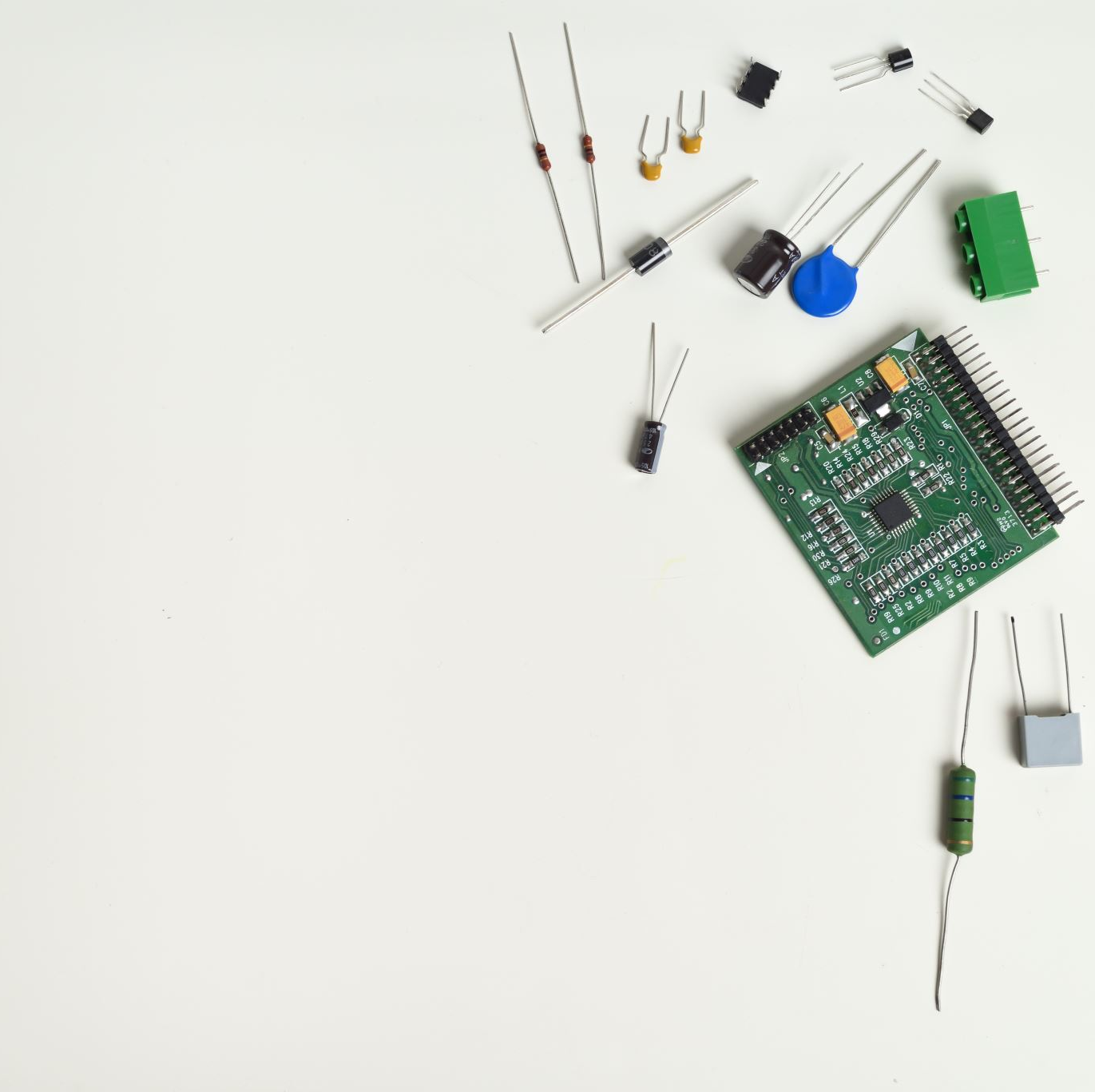
Logistics
Will you have access to a computer / laptop at home?
Will you be able to do some homework each day?

Slide 8
Code for Climate
How can we help fight climate change via coding

Slide 9
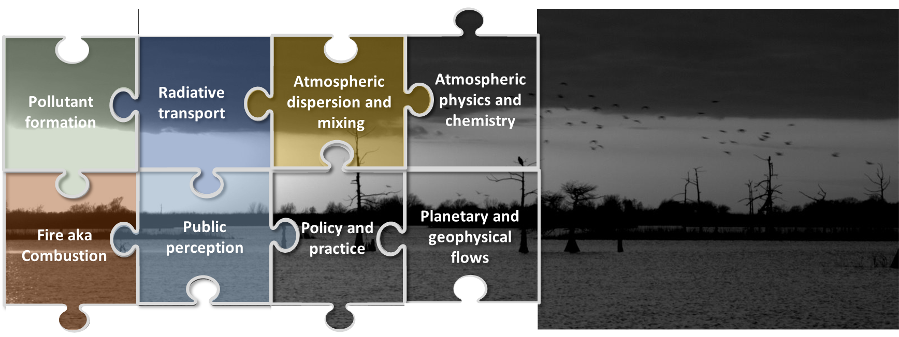
Climate is a big puzzle
It’s complex and multifaceted.

Slide 10
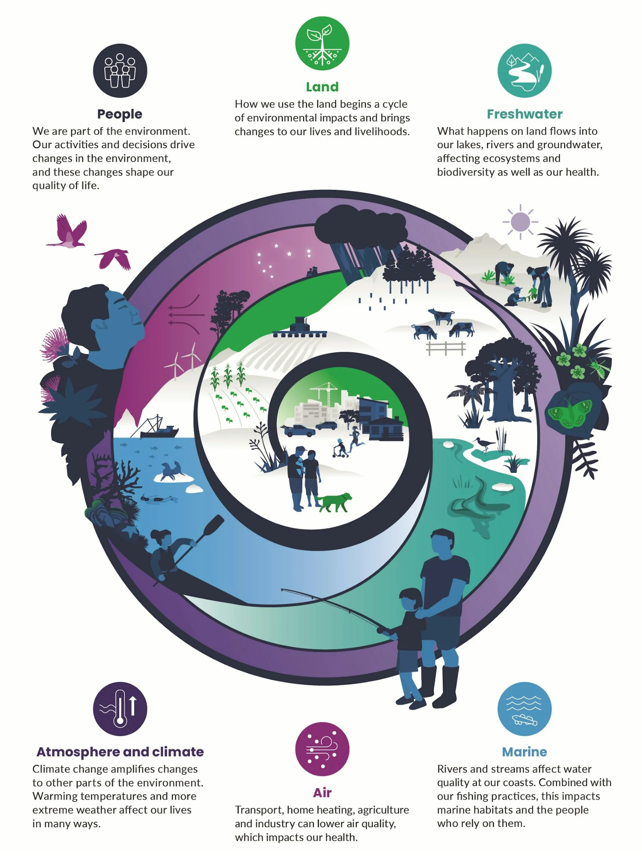
It affects our lives in many perceptible and imperceptible ways.
Some things such as health effects can be immediate
Other things such as loss of biodiversity is a slow process
https://www.sciencelearn.org.nz/images/iour-environment-2025i-infographic

Slide 11
By the end of this week
We will know something about the quality of the air we breathe in (via a metric called Air Quality Index or AQI) and learn to visualize some real air quality data using Python.

Slide 12

Let’s take a break
Let’s reconvene in 10 minutes.
In that time, write in a piece of paper what are the steps to make your favorite food that you mentioned earlier.

Slide 13

What is Coding?

Slide 14
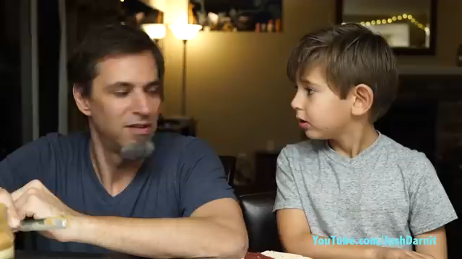
How computer programs work
https://www.youtube.com/watch?v=FN2RM-CHkuI

Slide 15
Making a snack
Review your steps in your group and suggest improvements to make it “computer ready”.

Slide 16
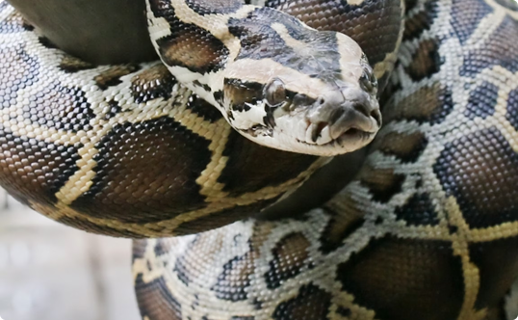
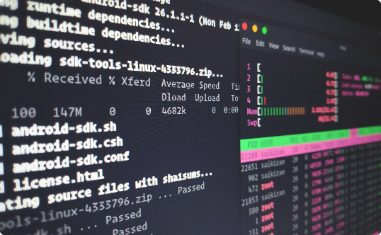
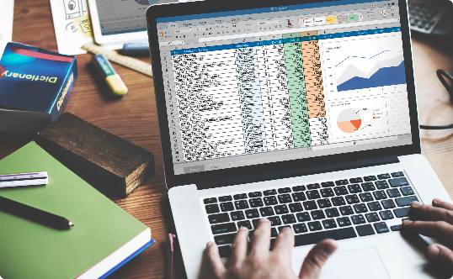
What is Python?
It’s not a snake 🐍
It's easy to learn 💻
It's versatile 🤹‍♀️
Python is a coding language used to create software, games, and websites.
Python has a simple vocabulary and is not bogged down with complex syntax. It’s easy for beginners to understand and use.
Python can be used for web development, game programming, data analysis and more.

Slide 17
Why Python is a Great Language for Beginners
Readability 📖
Simple Syntax 🤩
Community 😊
Python is easy to read and understand, making it accessible to beginners.
Python’s syntax is clean and straightforward, with fewer rules than other languages.
The Python community is supportive and welcoming to new learners. There are forums, blogs, and free resources available.

Slide 18
How to run python
Python can be run locally or remotely
We will be taking a remote-running route via Google Colab

Slide 19

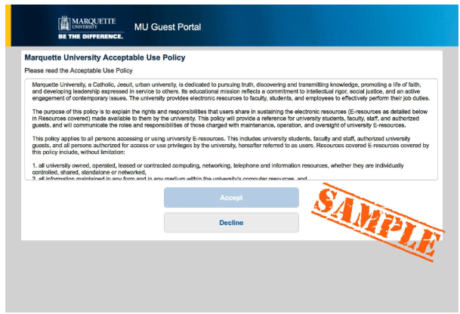
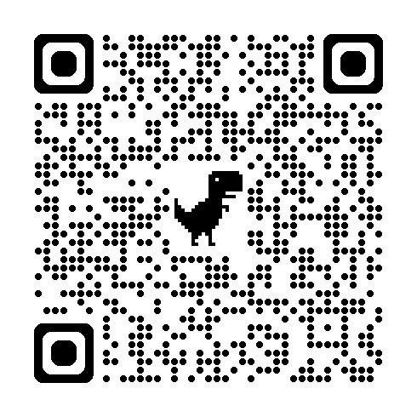
Let’s get setup to code! Wi-Fi Login
Select MU Guest
The "MU Guest Acceptable Use Policy" page appears, review the terms and conditions.
The Accept button will become actionable when you scroll through the terms.
If you agree, click or tap Accept.

Slide 20

Let’s get setup to code!
Do you have a personal Google account?
If not, you will need to create one
We will be working with Google Colab to do our programming

Slide 21

What is Google Colab?
Colab, or Colaboratory, allows you to write and execute Python in your browser, with
Zero setup required
Ease of sharing your code with others
We will be using an interactive way to write Python called Notebook. A Python notebook typically is stored as a .ipynb file.

Slide 22
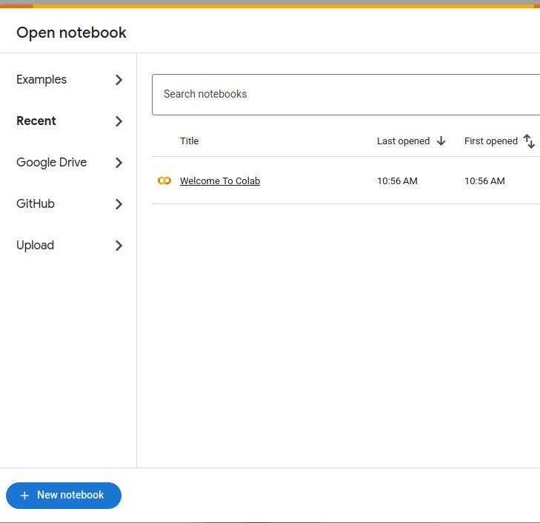
Getting started with Google Colab
Go to Google Colab
Type http://colab.research.google.com in your browser
or simply Google it!
Sign in with your personal Google account.
Create a new Notebook
Click on the ‘New Notebook’ button in the bottom left of the popup

Slide 23
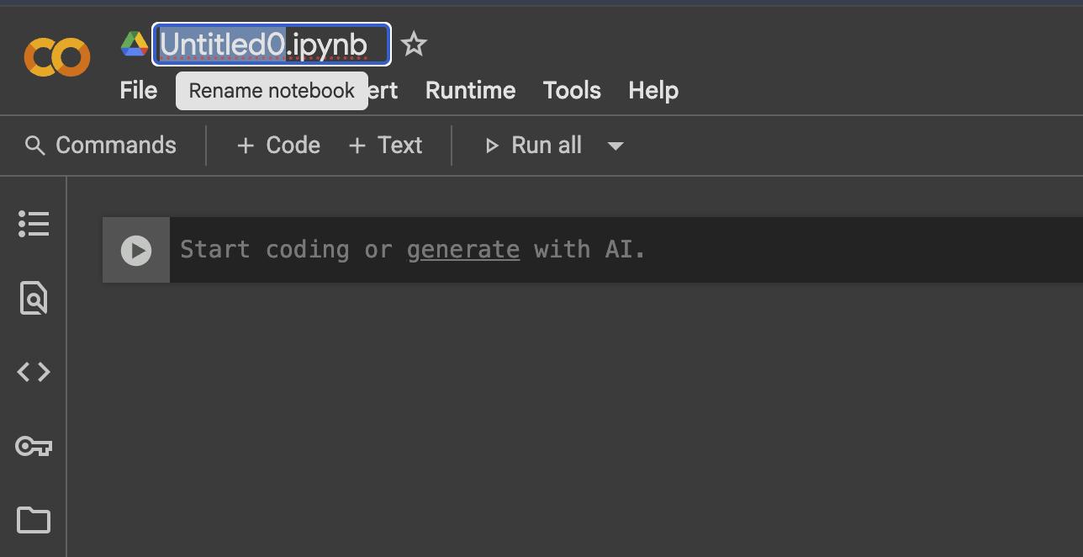
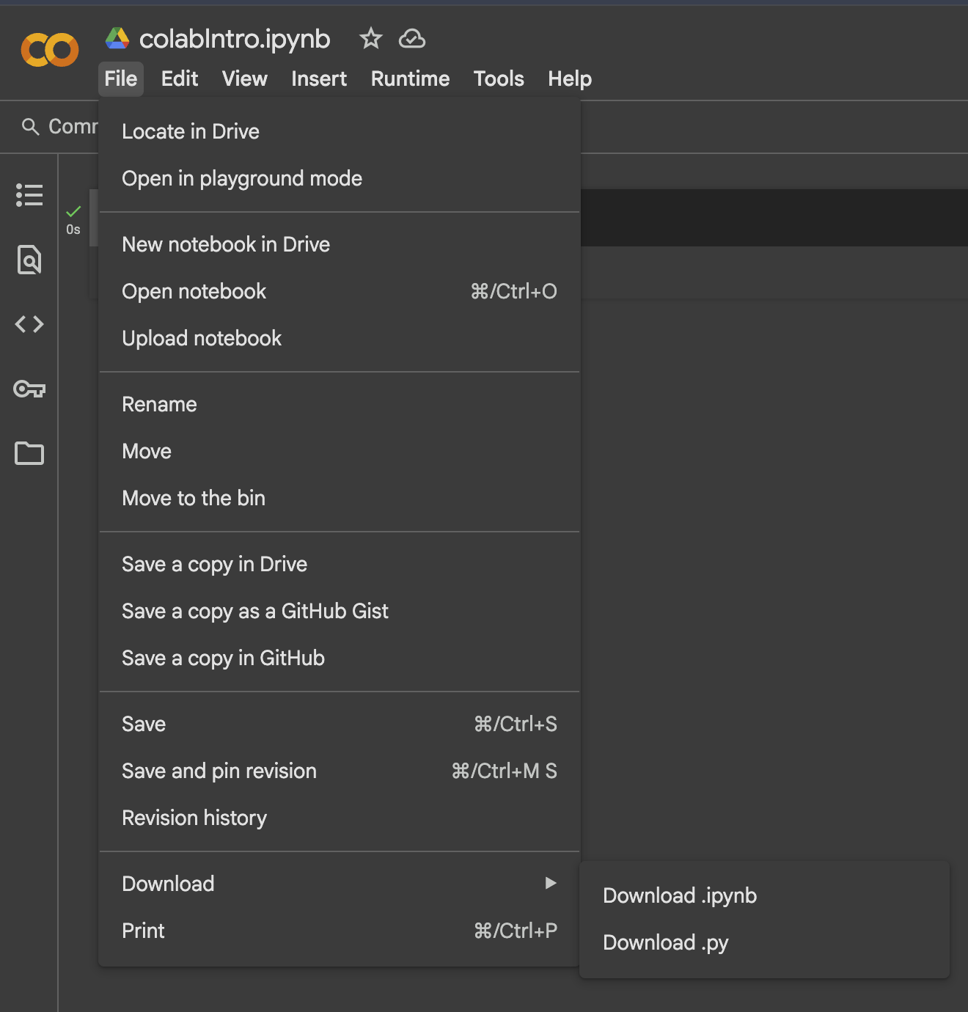
How to save your files
Save
Save your files with easy intuitive names.
e.g., colab_intro.ipynb
Drive
Save your notebooks to google drive
If you open a new notebook in drive, It automatically saves to your drive.
File > Save a copy in Drive
Download
Download your notebooks
File > Download > Download .ipynb

Slide 24
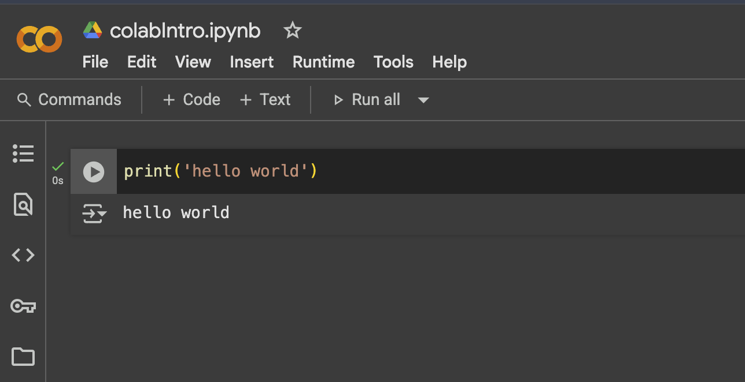
Hello, World!
Create a new notebook
Type
print(‘hello world’)
Click play
Now modify the code to add your name, like
Hello, World!
This is <your-name>

Slide 25

Let’s play a game
A simple Python code example
We need some words!

Slide 26

Closure
We learned a bit about climate and how it affects us
We accessed and navigated through a simple Python Notebook on Google Colab
We practice print and input statements
We learned about variables, data types, and some mathematical opeartors
We wrote a couple of Python programs
And, we made some new friends!
We will finish today with our first coding project on climate

Slide 27

Project Time
Connecting Back to Climate and Air: Calculating Heat Index

Slide 28
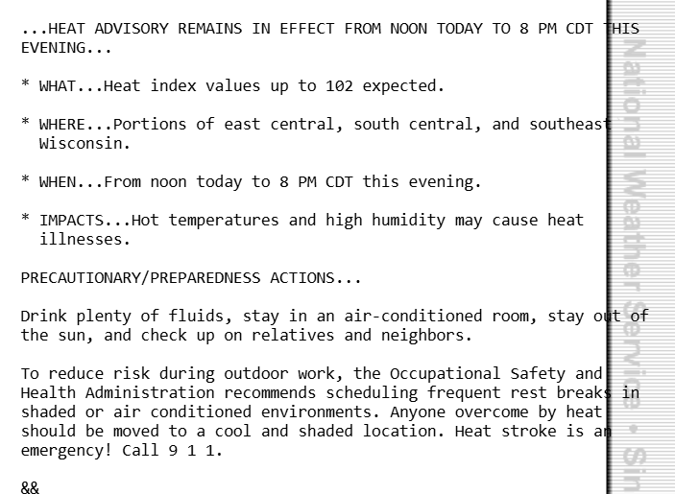
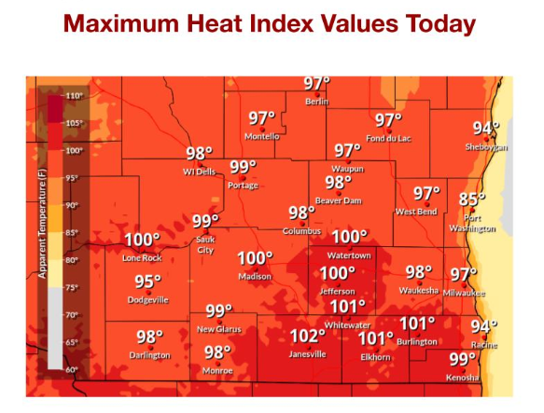
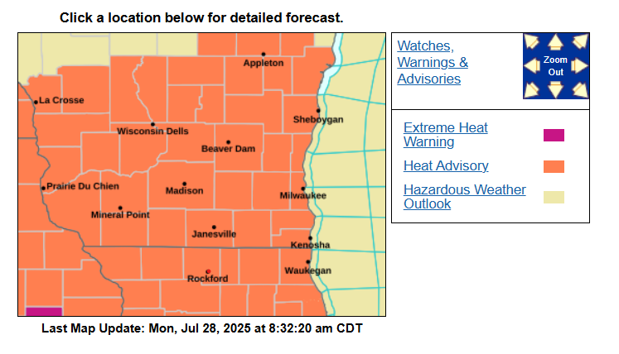
Today we are under a heat advisory!

Slide 29
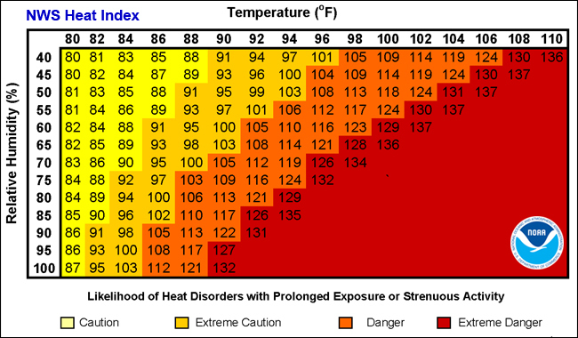
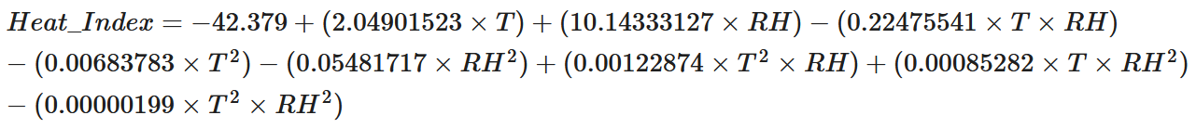
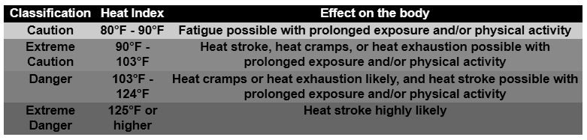
What is the Heat Index?
What the temperature feels like based on the combination of temperature and relative humidity
When we have a heat advisory, we are here!

Slide 30
Go back to the C4C webpage
www.eng.mu.edu/ccl/c4c

Slide 31
See you all tomorrow!

